Slide 1
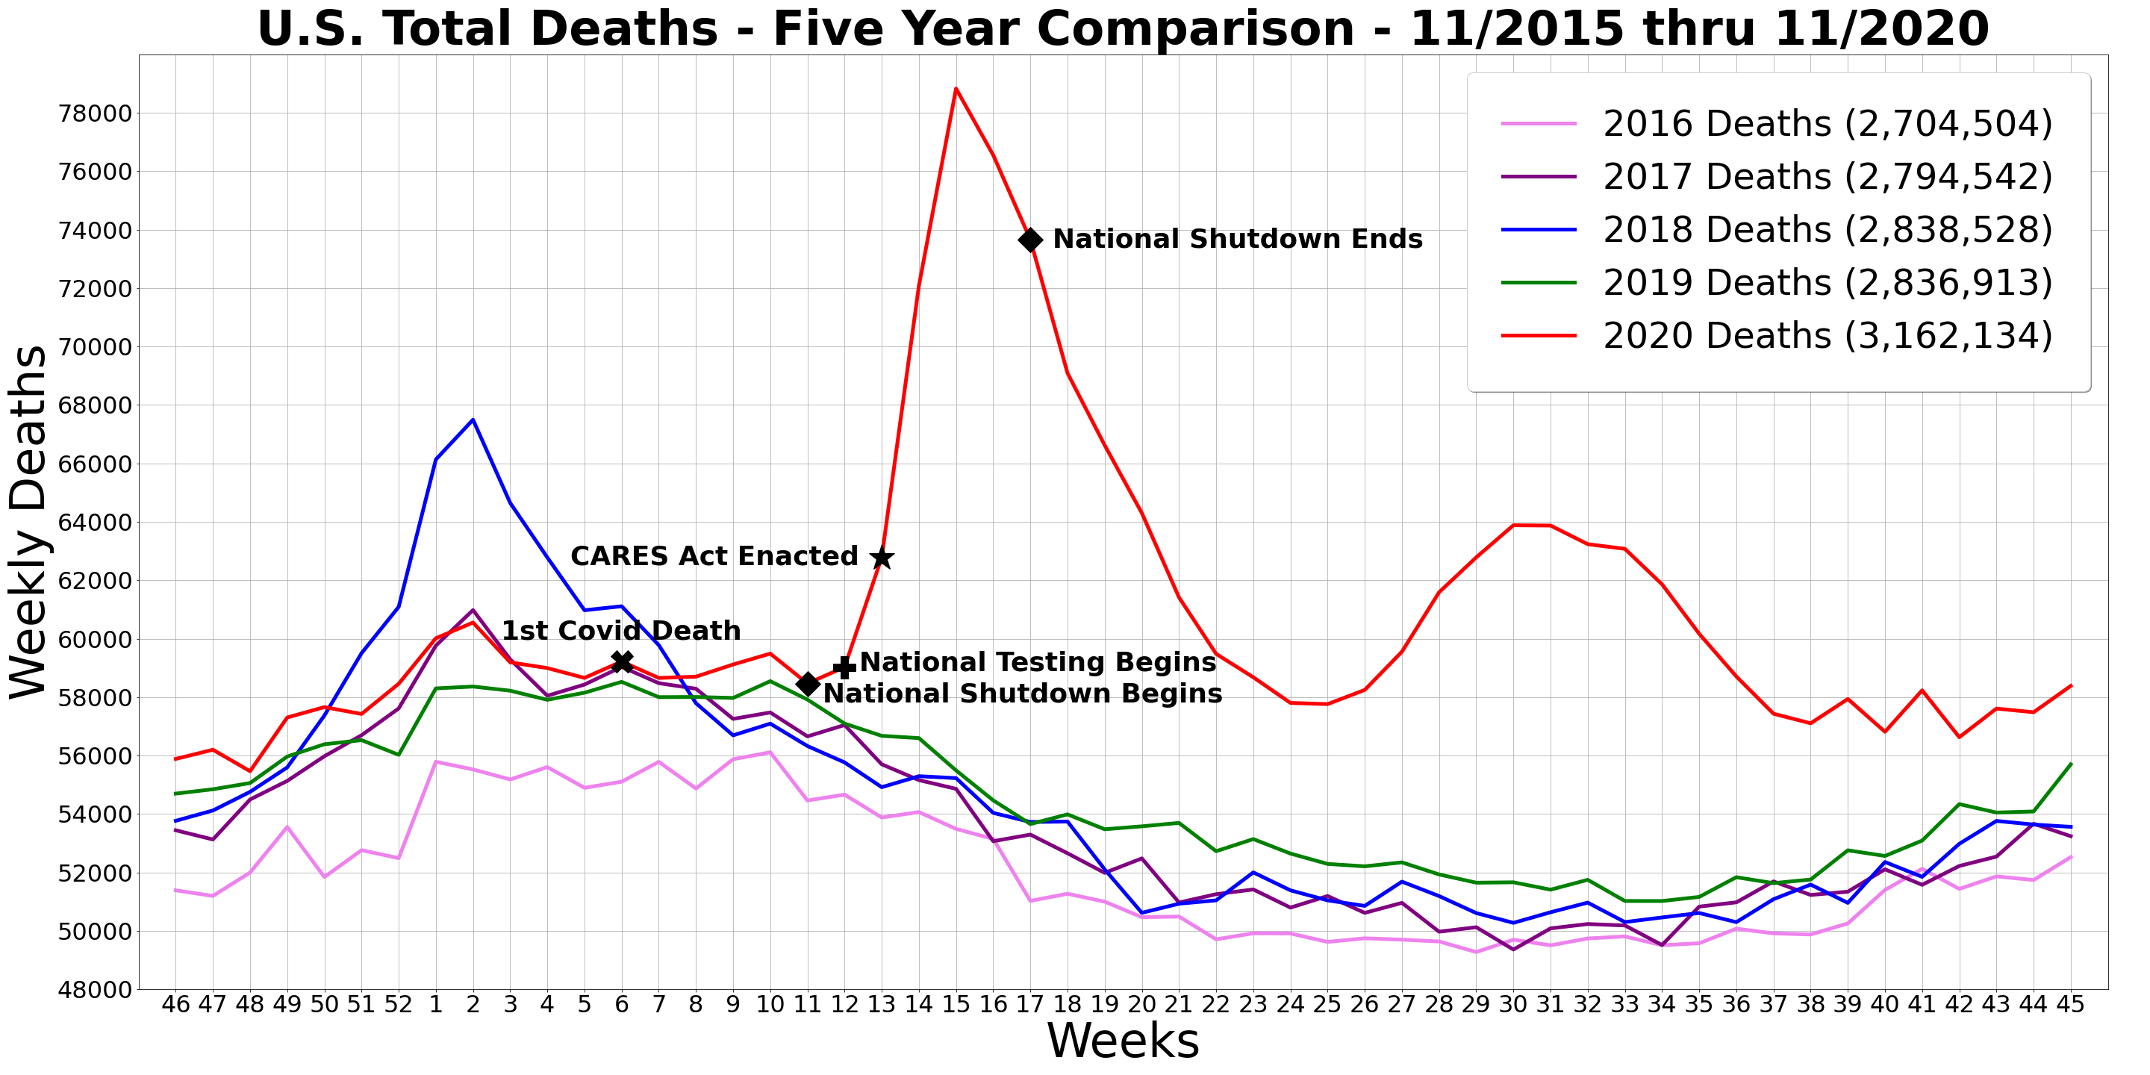
Outcome of mapping
* In a normal year, most deaths accumulate during the winter months. Mainly when many people are the least active, given cold weather conditions. This is also coincides with the peak of the flu season.

Slide 2
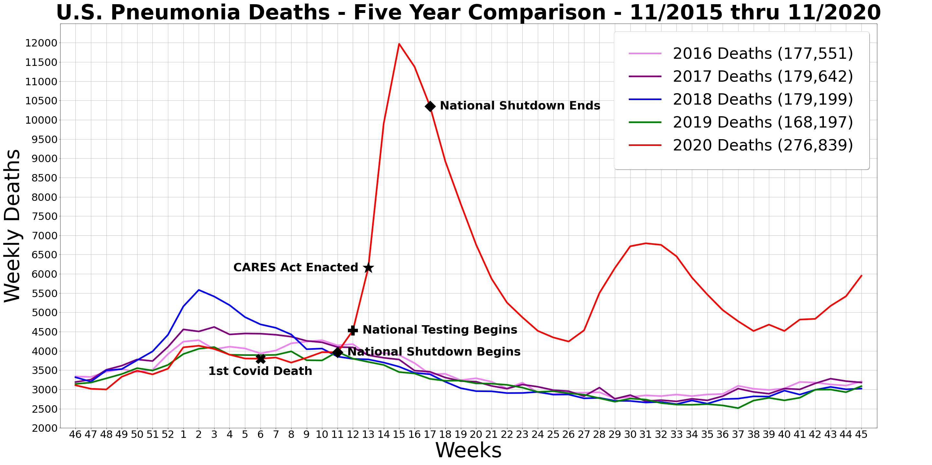
* Total pneumonia deaths saw about a 64.6% increase from 2019 to 2020. Pneumonia deaths normally account for most of the deaths associated with viral respiratory illnesses, given other viral symptoms are mostly manageable with existing medications.

Slide 3
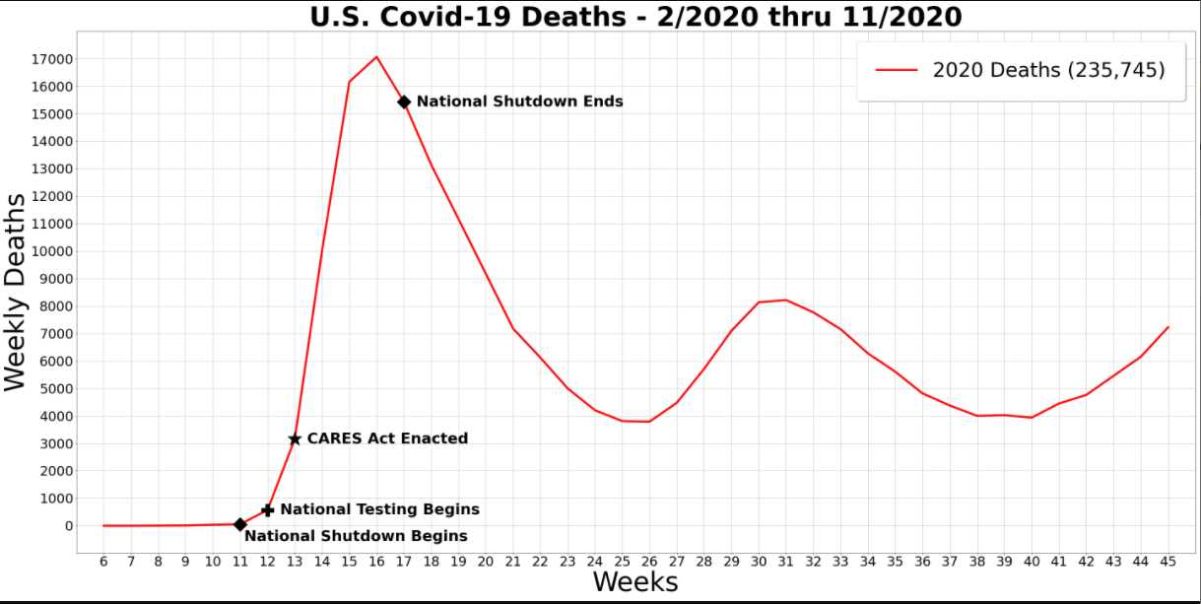

Slide 4
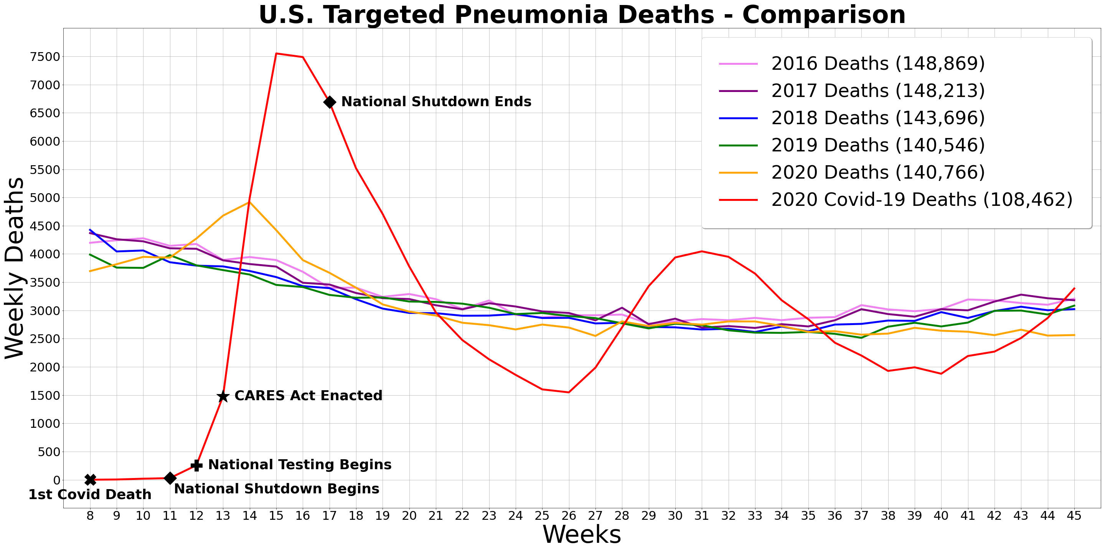
* This chart analyzes pneumonia deaths from the first Covid-19 death associated with it to early November, and compares it to previous timeframes in 2016-2019. Notice that 2020 deaths other than Covid-19 seemed slightly influenced by it.
** Correlation testing was done comparing 2020 pneumonia deaths other than Covid-19 with the previous years displayed with a minimum factor of 0.82, which represents a strong correlation.
*** ANOVA testing was done on the datasets in **, generating a 0.33 pvalue indicating there is no significant statistical difference in those datasets.

Slide 5
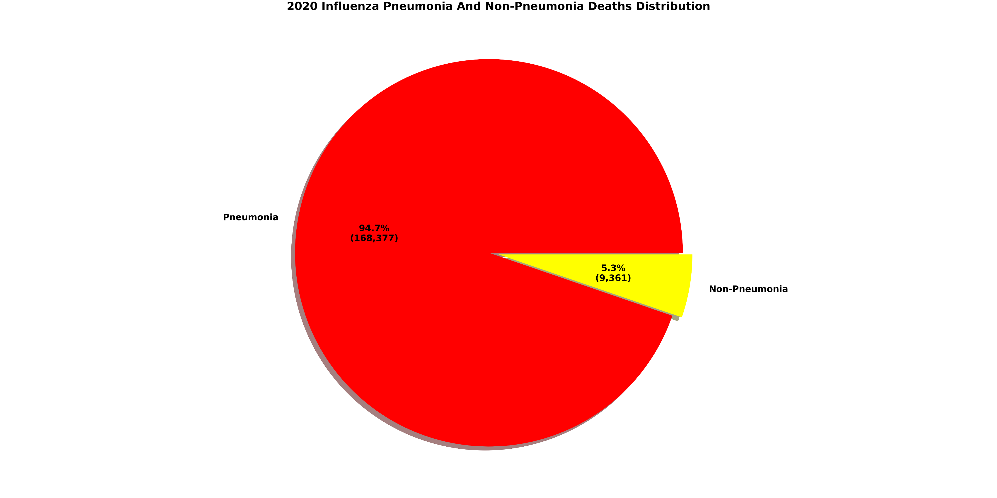
* Special Note: Data here could include bacterial and fungal pneumonia, which are rare.

Slide 6
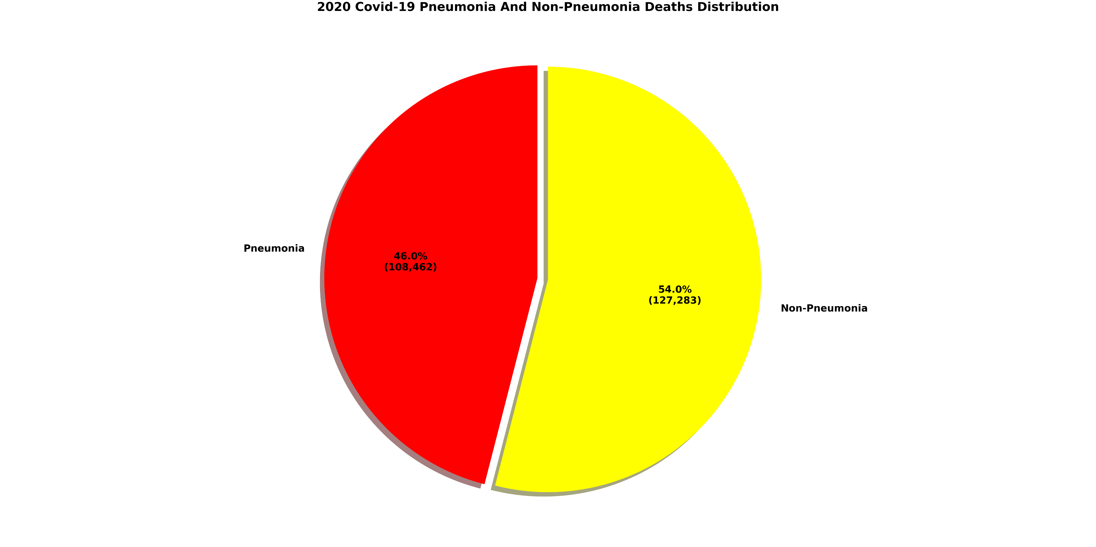
* Surprisingly, there seems to be more non-pneumonia deaths than there are pneumonia deaths related to Covid-19.

Slide 7
References, Thoughts, And A Final Question
https://www.cdc.gov/nchs/nvss/vsrr/covid_weekly/index.htm
Comorbidities
Table 3 shows the types of health conditions and contributing causes mentioned in conjunction with deaths involving coronavirus disease 2019 (COVID-19).
For 6% of the deaths, COVID-19 was the only cause mentioned. For deaths with conditions or causes in addition to COVID-19, on average, there were 2.9 additional conditions or causes per death.
https://www.aha.org/advisory/2020-04-16-coronavirus-update-cms-releases-guidance-implementing-cares-act-provisions
The Centers for Medicare & Medicaid Services (CMS) yesterday released new guidance implementing several provisions included in the Coronavirus Aid, Relief, and Economic Security (CARES) Act.
These provisions include:
A Medicare add-on payment of 20% for both rural and urban inpatient hospital COVID-19 patients;
Waiver of the long-term care hospital (LTCH) site-neutral policy for COVID-19 patients;
Waiver of the LTCH “50% Rule” for COVID-19 patients; and
Waiver of the inpatient rehabilitation facility (IRF) “3-hour Rule” for COVID-19 patients
The inactivity concerning the winter months that was previously mentioned was probably made worse by various factors associated with the Covid-19 response (shutdowns, unemployment, restrictions, fears, etc…).
Concerning the links above, the first shows that those with comorbidities were mostly likely to die from Covid-19, predominately the elderly who have them. The second shows that the hospitals were gave an economic incentive via the CARES act ($100 billion allocated) to identify and treat Covid-19 patients, whether they were insured or not, and whether they had or were being treated for other comorbidities or not.
General Calculations
235,745 Covid-19 Deaths x 0.06 = 14,144.7 Covid-19 Only Deaths
235,745 Covid-19 Deaths - 14,144.7 Covid-19 Only Deaths = 221,600.3 Covid-19 Deaths With Comorbidities
221,600.3 Covid-19 Deaths With Comorbidities / 3.9 Average Comorbidities Including Covid-19 = 56,820.59 Porportioned Covid-19 Deaths
56,820.59 Porportioned Covid-19 Deaths + 14,144.7 Covid-19 Only Deaths = 70,965.29 Weighted Covid-19 Deaths
A Final Question
Does a 54% proportion of non-pneumonia deaths associated with Covid-19 make sense to you?

